Slide 1
CARDIAC EMBRYOLOGY EARLY DEVELOPMENT OF HEART
Dr.Santhosh Narayanan

Slide 2
FORMATION OF TRILAMINAR EMBRYO
CARDIOGENESIS
MOLECULAR DEVELOPMENT OF HEART
DEVELOPMENTAL ABNORMALITIES

Slide 3
The Beginning
DAY 0 - FERTILISATION
DAY 1 -4 - CELL DIVISION- MORULA
DAY 5-6 - BLASTOCYST
DAY 7-10 - IMPLANTATION

Slide 5
Bilaminar embryo (Days 11-14)
EPIBLAST
HYPOBLAST

Slide 6
The Amnion and Yolk sac

Slide 7
Primitive streak week 3

Slide 8
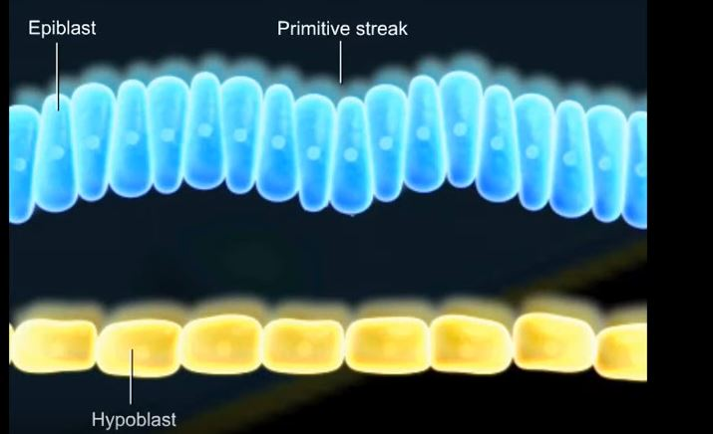

Slide 9
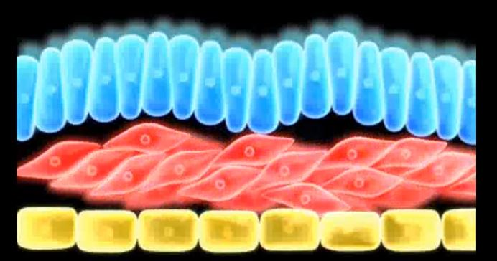
Gastrulation - Week 3

Slide 10
Neurulation

Slide 11
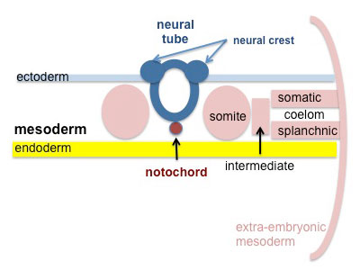
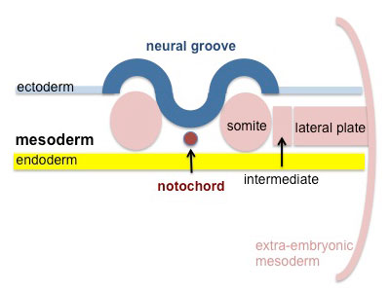
Neurulation

Slide 12
Derivatives of Germ layers

Slide 13
The Cardiogenesis

Slide 14
CARDIOGENESIS
Formation of bilateral heart fields
Formation of the heart tube
Folding of the heart tube
Looping of the heart tube
Chamber specification and compaction

Slide 15
Cardiac precursor cells
First heart field
Second heart field
Neural crest cells
Pro epicardium

Slide 16
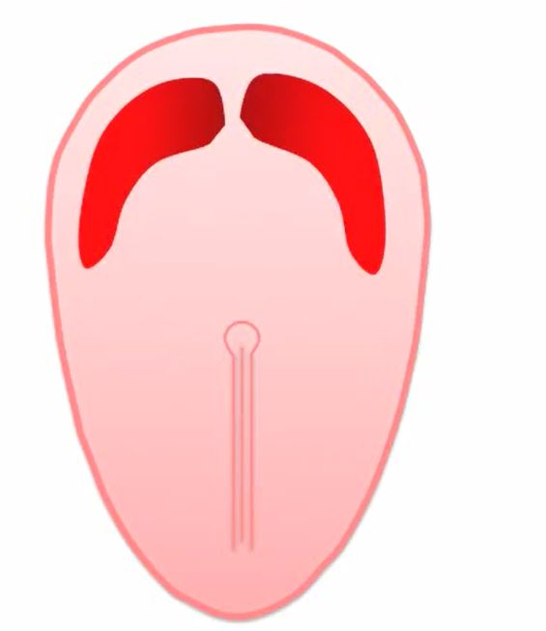
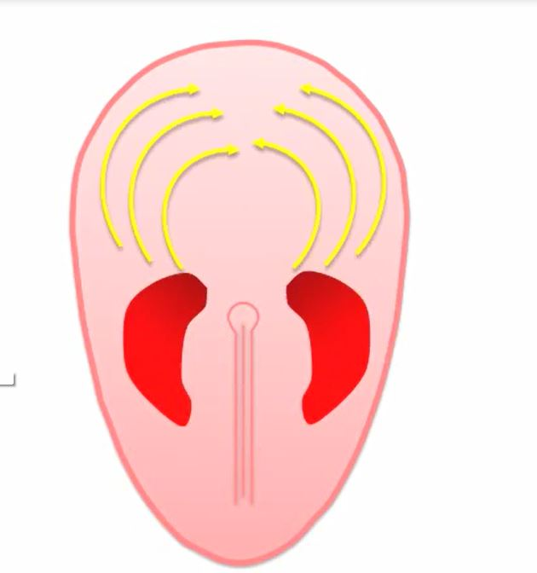

Slide 17
The "Cardiac Crescent"

Slide 18
The second heart field

Slide 19
3rd Heart field

Slide 20
The Cardiac Neural crest

Slide 21
Sequence of Events
Day I8 - Cardiac precursor cells seen in the form of blood islands
Day 20 - First intraembryonic blood vessels
Day 21- Folding, heart tube formation,looping
Day 22 – heart starts to beat
Day 28 – embryonic circulation established

Slide 22
Folding of Embryo
CRANIOCAUDAL AXIS
More rapid growth of the neural tube forming the brain at its cephalic end.
Growth in this direction will cause the embryo to become convex shaped.
LATERAL FOLDING
Two lateral edges of the germ disk fold forming a tube-like structure

Slide 23
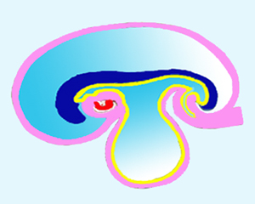
Folding of embryo

Slide 24
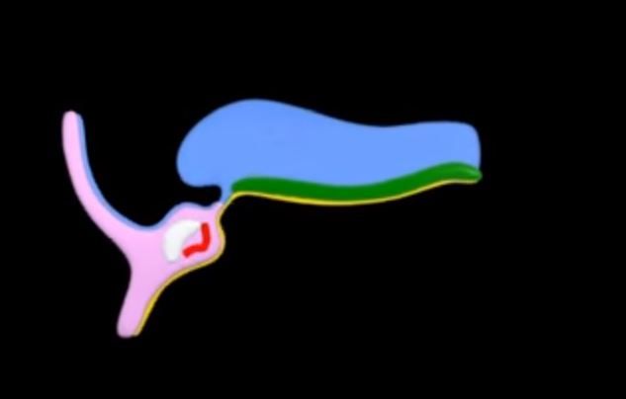

Slide 25
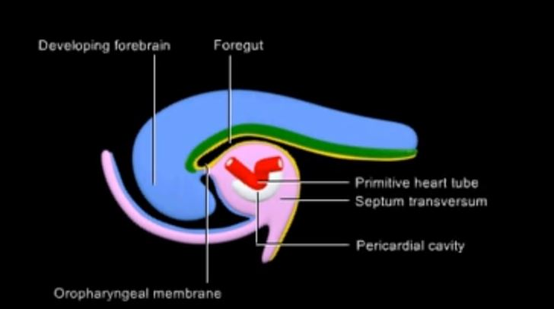
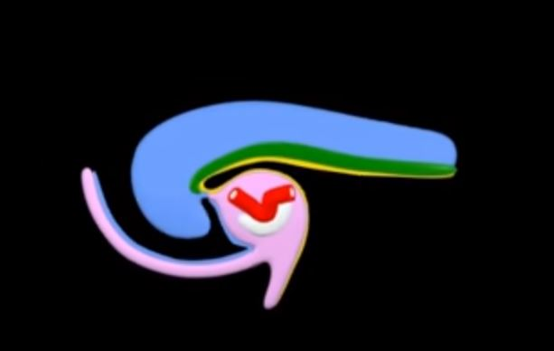

Slide 26
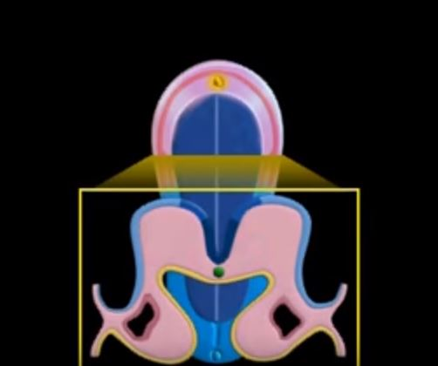

Slide 28
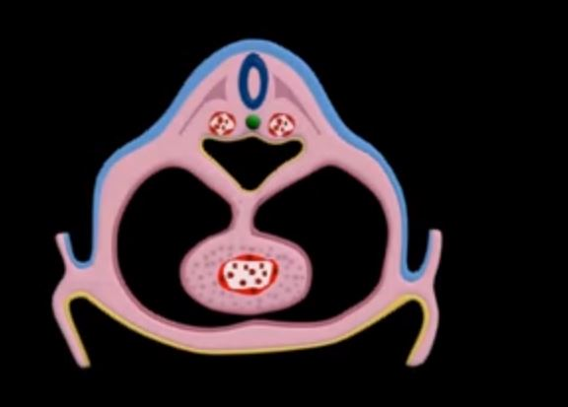

Slide 29
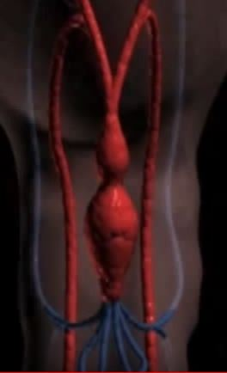
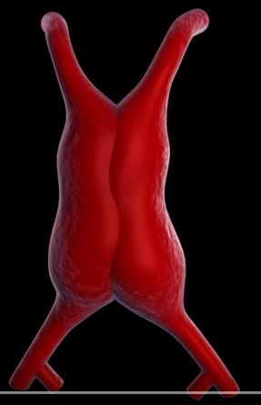
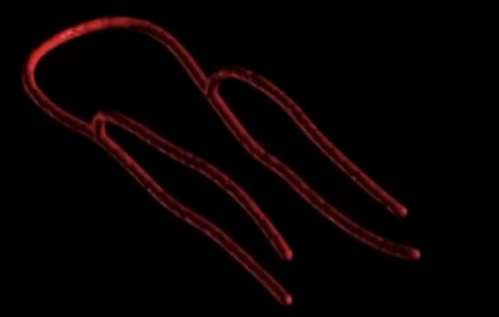
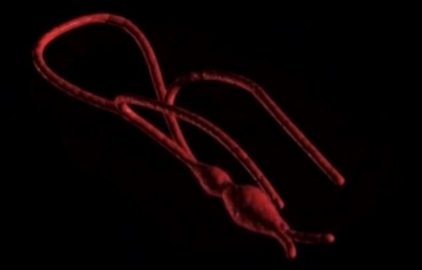

Slide 30
Arterial end of the heart tube
BULBUS CORDIS
proximal part called the conus
a distal part called truncus arteriosus.
The truncus continues distally with the aortic sac.

Slide 31
Venous end
The sinus venosus
vitelline vein from the yolksac
umbilical vein from the placenta
common cardinal vein from the bodywall

Slide 33
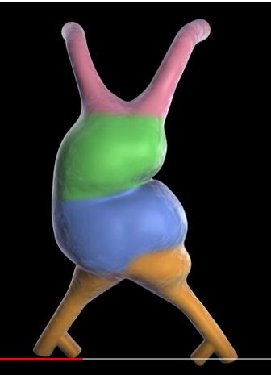
Looping

Slide 34
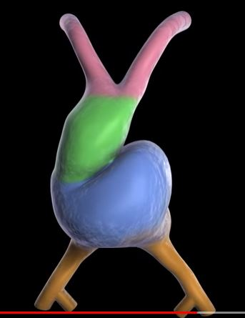
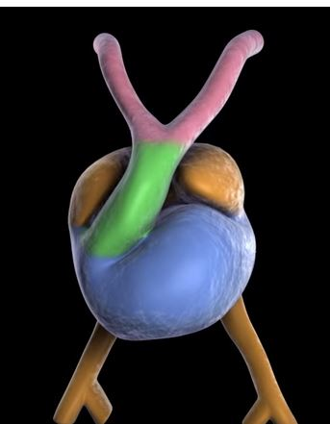
Looping

Slide 35
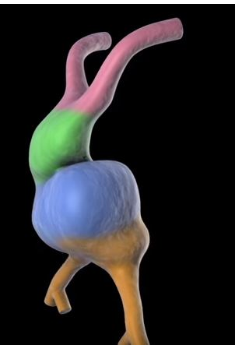
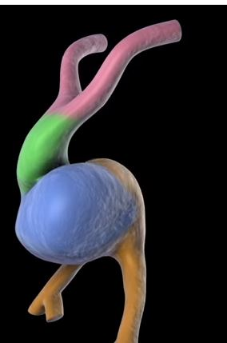
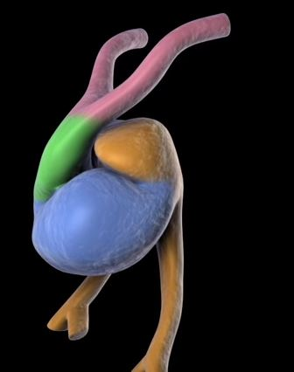

Slide 36
Mechanism of looping
Differential growth of the heart tube in comparison with foregut
Differential growth within the heart tube itself
Posterior, leftward, slower growth and anterior, rightward, faster growth resulting in RIGHTWARD LOOPING

Slide 37
Bending of the heart tube at the inflow as well as within the ventricular segment
eventually positions the inflow and future left ventricular segments posteriorly and to the left, with the future right ventricle and outflow segments anteriorly and to the right

Slide 38
b

Slide 39
Convergence
Movement of the outflow tract and the atrioventricular canal into a more midline position
Alignment

Slide 40
Wedging
Seperation (septation) of the primitive ventricles and outflow tract into systemic (aorta) and pulmonary (pulmonary artery) trunks is created by a process called wedging
The counterclockwise rotation of the outflow tract with movement of the future aortic valve position behind the pulmonary trunk

Slide 41
Convergence and Wedging

Slide 42
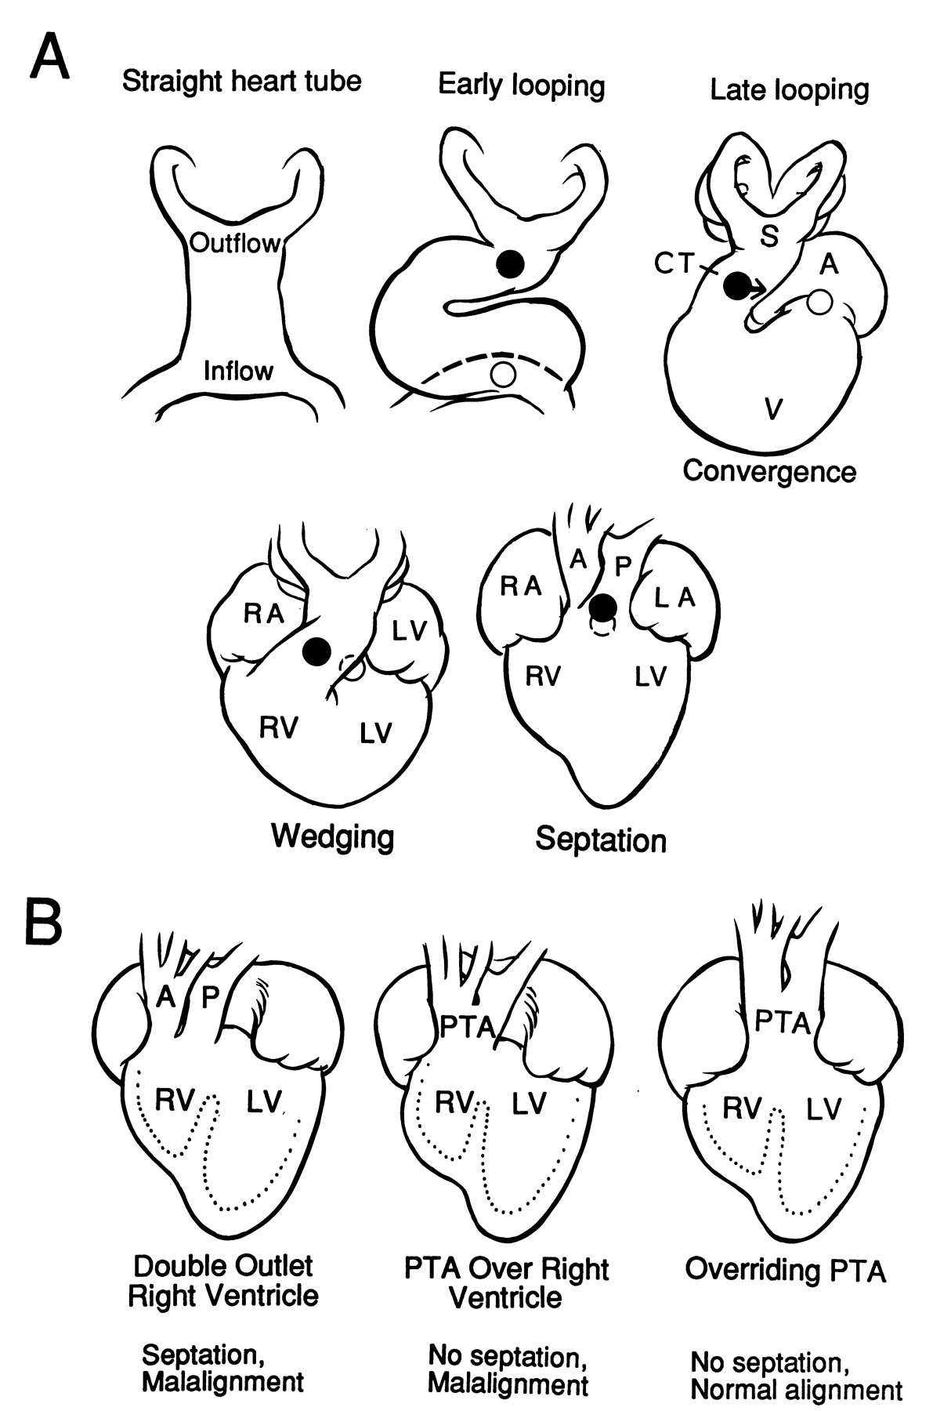

Slide 43
Myocardial Compaction
Emergence of trabeculations
Trabecular remodelling

Slide 44
Emergence of trabeculations
Emerge after looping of the primitive heart tube
At the end of the fourth week of gestation
Trabeculation patterns are ventricle-specific
trabeculations in the LV are generally thicker and the corresponding intertrabecular spaces larger

Slide 45
Trabecular remodeling
After completion of ventricular septation at 8 weeks of gestation in
Increase in ventricular volumes results in compression of the trabeculations with an increase in the thickness of the compacted myocardium
Compaction process coincides with the invasion of epicardial coronary arteries

Slide 48
Evolution of human heart
Progressive displacement of the inflow structures from a caudal position to a dorsal (fishes) and cephalad (reptiles) position.
Septation of the atrium in a right and a left cavity (amphibians).
Development of the right ventricle (RV) from the proximal part of the conus arteriosus.

Slide 49
Septation starting at the interventricular groove separating the left from RV (crocodiles).
Development of a high-pressure left ventricle (LV) and a low-pressure RV.
Disappearance of the sinus venosus and the conus arteriosus (birds and mammals).

Slide 50
Molecular development of heart

Slide 52
Genes in induction of crescent
Anterior (cranial) endoderm induces a heart-forming region by inducing the transcription factor NKX2.5.
The signals require secretion of BMPs 2 and 4 secreted by the endoderm and lateral plate mesoderm.
Concomitantly, the activity of WNT proteins (3a and 8) secreted by the neural tube, must be blocked because they normally inhibit heart development.
The combination of BMP activity and WNT inhibition by crescent and cerberus causes expression of NKX2.5.

Slide 54
Genes in differentiation

Slide 56
Right left asymmetry

Slide 57
Signalling networks
NOTCH
BMP
WNT
FGF
SEMAPHORIN

Slide 60
Developmental abnormalities

Slide 61
From Fertilization to Primitive Heart Tube
-Abnormal development at this stage of
embryogenesis results in embryonic death because of the critical nature of the early circulation to the further growth

Slide 62
Abnormal left right signalling
HETEROTAXY SYNDROMES
-Right Isomerism
-Left Isomerism
-Situs inversus with dextrocardia

Slide 63
Heterotaxy spectrum

Slide 64
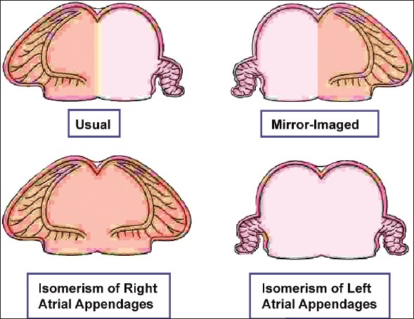

Slide 66
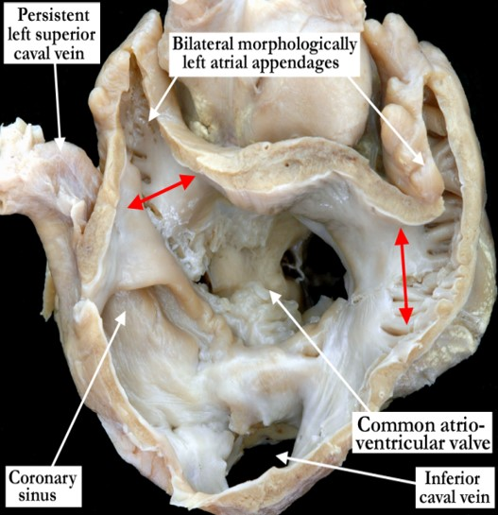

Slide 68
Right Isomerism
Cardiac :
The sinus nodes are paired because bilateral superior vena cavae are attached to bilateral morphologic right atria.
The P-wave axis is normal because the right sinus node is usually the dominant atrial pacemaker
The atrioventricular conduction system is equipped with 2 nodes often connected by a sling of tissue
Supraventricular tachycardia is attributed to reentry between paired atrioventricular nodes.

Slide 69
Right Isomerism- Associations
common atrium,
common atrioventricular valve,
Morphologic single ventricle,
Functional single ventricle (hypoplasticright or left),
pulmonary stenosis or atresia,
absent coronary sinus
total anomalous pulmonary venous connection
bilateral ductus arteriosus.
Ventricular and great arterial connections are usually discordant.

Slide 70
Left Isomerism
More prevalent in women
The pulmonary veins can be connected in a symmetric fashion, 2 to the right-sided atrium and 2 to the left-sided atrium
The most distinctive and the most diagnostically useful clinical feature is inferior vena caval interruption with azygous continuation, in which the suprarenal segment of the inferior cava is absent, and the infrarenal segment continues as the azygos or hemiazygous vein
Fetal complete heart block is presumptive evidence of in utero left isomerism

Slide 71
Left Isomerism
Sinus node is absent or hypoplastic.
The atrial pacemaker is therefore ectopic, and the P-wave axis is abnormal.
The ectopic atrial pacemaker can shift from 1 site to another or may fire slowly (ectopic atrial bradycardia

Slide 72
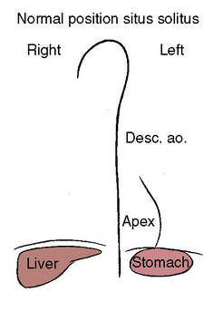
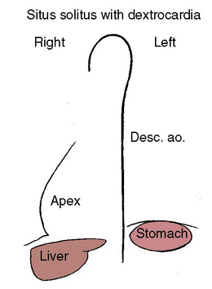
Malpositions due to looping defects

Slide 73
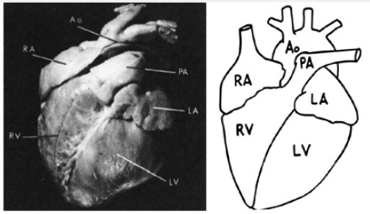
Situs solitus with Dextrocardia
Isolated dextrocardia with AV concordance and NRGA
The base-to-apex axis points to the right, right hemidiaphragm is lower
The embryonic straight heart tube initially bends rightward (d-loop) but fails to move into the left chest.
Congenital heart defects:
ventricular septal defect
left SVC to the coronary sinus
coarctation of the aorta
secundum atrial septal defect
anomalous pulmonary venous connections
complete AV septal defect

Slide 74
ECG
atrial activation is normal, and the P-wave frontal plane axis is 70 to 80
the frontal plane QRS axis exhibits a rightward shift or right-axis deviation
a gradual and progressive reduction in the QRS R-wave voltage is observed

Slide 75
Corrected Transposition of the Great Arteries
Isolated Dextrocardia with AV and VA Discordance and Left Anterior Aorta
most common form of dextrocardia
Notes:
.

Slide 76
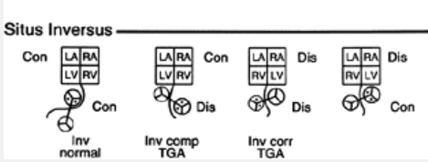
Situs Inversus

Slide 77
Situs inversus with Dextrocardia
Incidence 1 in 8,000
The thoracic and abdominal viscera are mirror images of normal
morphologic right bronchus is concordant with the morphologic right atrium and a trilobed lung
usually occurs with a structurally normal heart

Slide 78
ECG
Situs inversus with Dextrocardia: reversed ventricular activation and reversed repolarization.
lead 1: QRS negative & the T wave inverted,
lead aVR resembles aVL and vice versa,
right precordial leads resemble leads from corresponding left precordial sites.
Septal Q waves appear in right precordial leads because septal depolarization is from right to left.

Slide 79
Situs inversus with Dextrocardia Inverted Normally Related Great Arteries (Left Posterior Aorta)
Situs inversus totalis with persistence of normal AV and VA connections
CHD :
VSD
TOF
pulmonary atresia
complete AV septal defect
OS ASD.
Notes:
2. the atria, ventricles, and great arteries are all inverted from their normal location and spatial relationships
Common form of dextrocardia in normal hearts and situs inversus totalis

Slide 80
Situs Inversus with Dextrocardia, Atrioventricular Concordance, and Ventriculoatrial Discordance with Left Anterior Aorta
Inverted form of complete TGA
The hemodynamics and physiology identical to TGA
ECG :
inverted P-wave axis because of the atrial inversion
more evidence of associated right and left ventricular hypertrophy because of transposition physiology

Slide 81
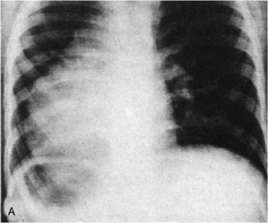
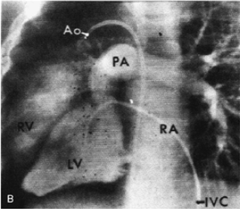
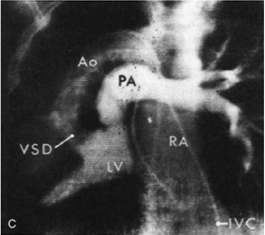
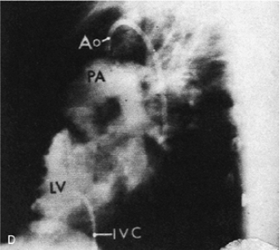
Situs Inversus with Dextrocardia Atrioventricular and Ventriculoatrial Discordance, with Right Anterior Aorta
Inverted form of corrected TGA
Rare

Slide 82
Situs Inversus with Dextrocardia, AV Discordance, and VA Concordance with Inverted NRGA
Represents the inverted form of isolated ventricular inversion
extremely rare
cardiac abnormalities
common atrium
common AV valve
severe right ventricular hypoplasia.

Slide 84
MCQ'S

Slide 85
1.Coronary vessels develop from
A. FHF
B.SHF
C.Neural Crest
D.Proepicardium
Answer D

Slide 86
2.All of the following are false except
A.Right isomerism is associated with ectopic pacemaker
B.Lungs are trilobed in left isomerism
C.Complete heart block is presumptive evidence of right isomerism
D.Interrupted IVC is seen in left isomerism
Answer D

Slide 87
3.Intraembryonic blood vessels are seen on
A. Day 18
B.Day 19
C.Day 20
D.Day 22
Answer C

Slide 88
4.All of the following are correctly matched except
A- NKX 2.5- Cardiac crescent induction
B. eHand- RV myocyte
C. TBX5- Septation
D. GATA factors -Heart tube formation
Answer B

Slide 89
5.Which of the following is false
A.Mesocardia is always associated with congenital heart defects
B.CCTGA-AV concordance with VA discordance
C.Situs inversus with dextrocardia usually occurs with a structurally normal heart
D.Right hemidiaphragm is lower in situs solitus with dextrocardia
Answer B

Slide 90
THANK YOU
House model of HEART

